Slide 1
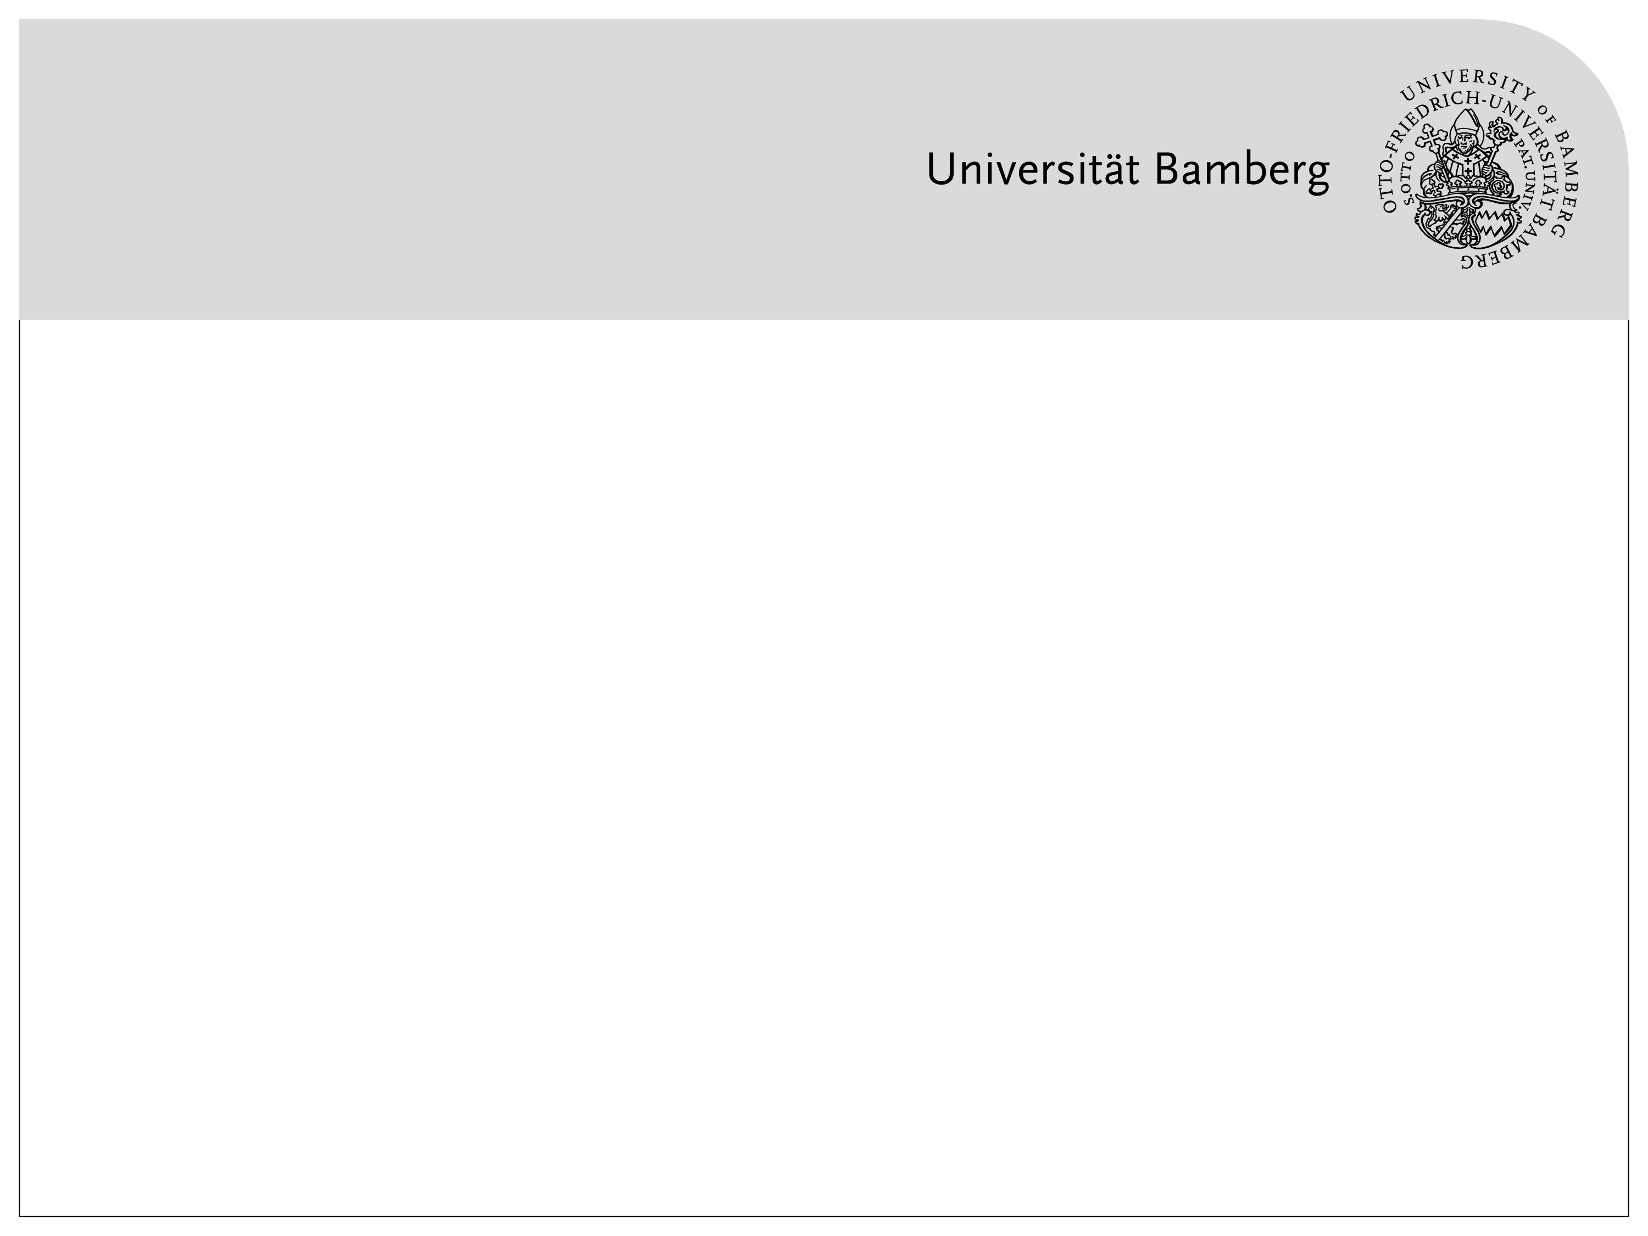
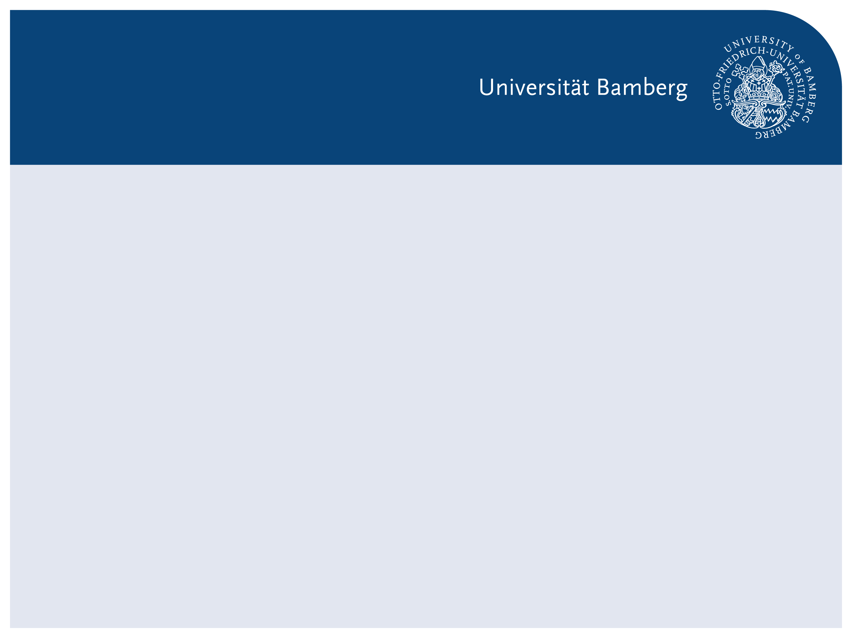
From Accuracy to Explainability: Understanding CNN Errors with xAI
xAI-Proj-B Course Project – CNN-based Image Classification

Slide 2
Presentation Outline
1. Baseline Model Construction
Motivation and experimental design
Four-model comparison under controlled factors
Performance results and limitations
2. Explainability-Driven Analysis
Difficulty-based sample categorization
Analysis of high-confidence wrong predictions
Visual explanations and feature-level pattern analysis

Slide 3
CNN Model Setup
Backbone architecture: ResNet-18
Task adaptation: Original classification layer replaced with a 10-class classifier (household object classification)
Key design principle: Same architecture across all models → only pretraining source and training strategy vary

Slide 4
Dataset Overview: ImageNet Subset (10 Household Object Classes)
Split | Samples | Samples/ Class
Train | 13000 | 1,300
Validation | 500 | 50
Test | 4409 | unbalanced (≈427–466)
Total | 17,909 | —
Preprocessing & Transformations
Images resized and normalized for CNN input
Random data augmentation applied during training only
Deterministic preprocessing for validation and test
Dataset Usage
Training set: parameter learning
Validation set: model selection
Test set: final performance evaluation (no tuning)

Slide 5
Stage 1: Baseline Model Construction.
Research Question (Stage 1):
How do different pretraining sources and training strategies affect CNN performance on a household object classification task?
Controlled Factors
Pretraining source
Training strategy
 | Frozen backbone | Fine-tuning
ImageNet | Model IN-LP | Model IN-FT
Flowers | Model FL-LP | Model FL-FT

Slide 6
Baseline Results: Accuracy Comparison
Compare IN-LP → IN-FT (▲ 0.014) and FL-LP → FL-FT (▲ 0.02) to assess the effect of fine-tuning.
Compare IN-LP (▲ 0.018) → FL-LP and IN-FT(▲ 0.012) → FL-FT to assess the effect of pretraining source.
Models | Validation accuracy | Test accuracy
Model IN-LP | 0.836 | 0.418
Model IN-FT | 0.850 | 0.438
Model FL-LP | 0.818 | 0.422
Model FL-FT | 0.838 | 0.424

Slide 7
Plausible Interpretations of Baseline Results
Fine-tuning: role of representation adaptation to the target task
ImageNet pre-training: role of feature diversity and transferability
Validation–test gap: motivates explainability-based analysis

Slide 8
From Performance to Explainability
New questions:
How does the model make wrong decisions?
Can xAI help us understand these errors?
Next: Error analysis & explainable AI methods

Slide 9
Why Sample-Level Analysis?
Limitation of Aggregate Metrics
Accuracy averages over samples
Risky errors are hidden
Our Idea
Look at individual predictions
Combine:
correctness
confidence
loss

Slide 10
From Performance Drop to Sample-Level Analysis
Motivation
Large performance drop from validation to test set
Accuracy alone cannot explain this behavior
Limitation of Aggregate Metrics
Accuracy averages over all samples
Different errors have different risks
High-confidence wrong predictions are especially problematic
Our Approach
Move from aggregate metrics to individual predictions
Analyze errors using:
correctness
confidence
loss

Slide 11
Sample-Level Difficulty Analysis
Per-sample confidence and loss
Focus on high-confidence wrong predictions (HCW)
Enables behavior-level comparison across models
Model In-LP on Test, Top conf wrong (first 1)
id | ture_label | pred_lebel | confidence | loss | Top2_ margin
2985 | Soup_bowl | Wooden_spoon | 0.999974 | 13.445731 | 0.999956
… | … | … | … | … | …

Slide 12
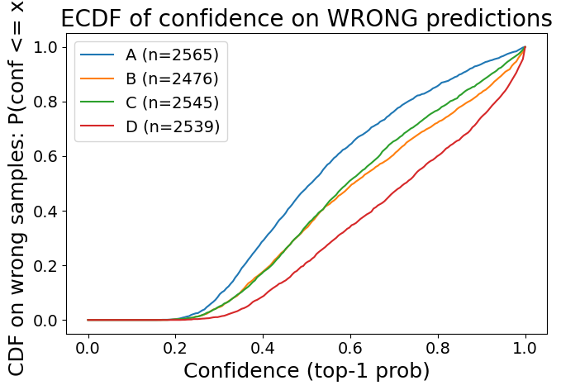
Error Confidence Distributions

Slide 13
Error Confidence Distributions Differ Across Models
Highlight:
Similar accuracy
Very different error confidence profiles
model | acc_ test | Wrong counts | wrong_conf_ Median | wrong_ conf>=0.9 | HCW counts
IN-LP | 0.418 | 2565 | 0.510630 | 0.062768 | 161
IN-FT | 0.438 | 2476 | 0.607954 | 0.167609 | 415
FL-LP | 0.422 | 2545 | 0.592722 | 0.124951 | 318
FL-FT | 0.424 | 2539 | 0.725225 | 0.256400 | 651

Slide 14
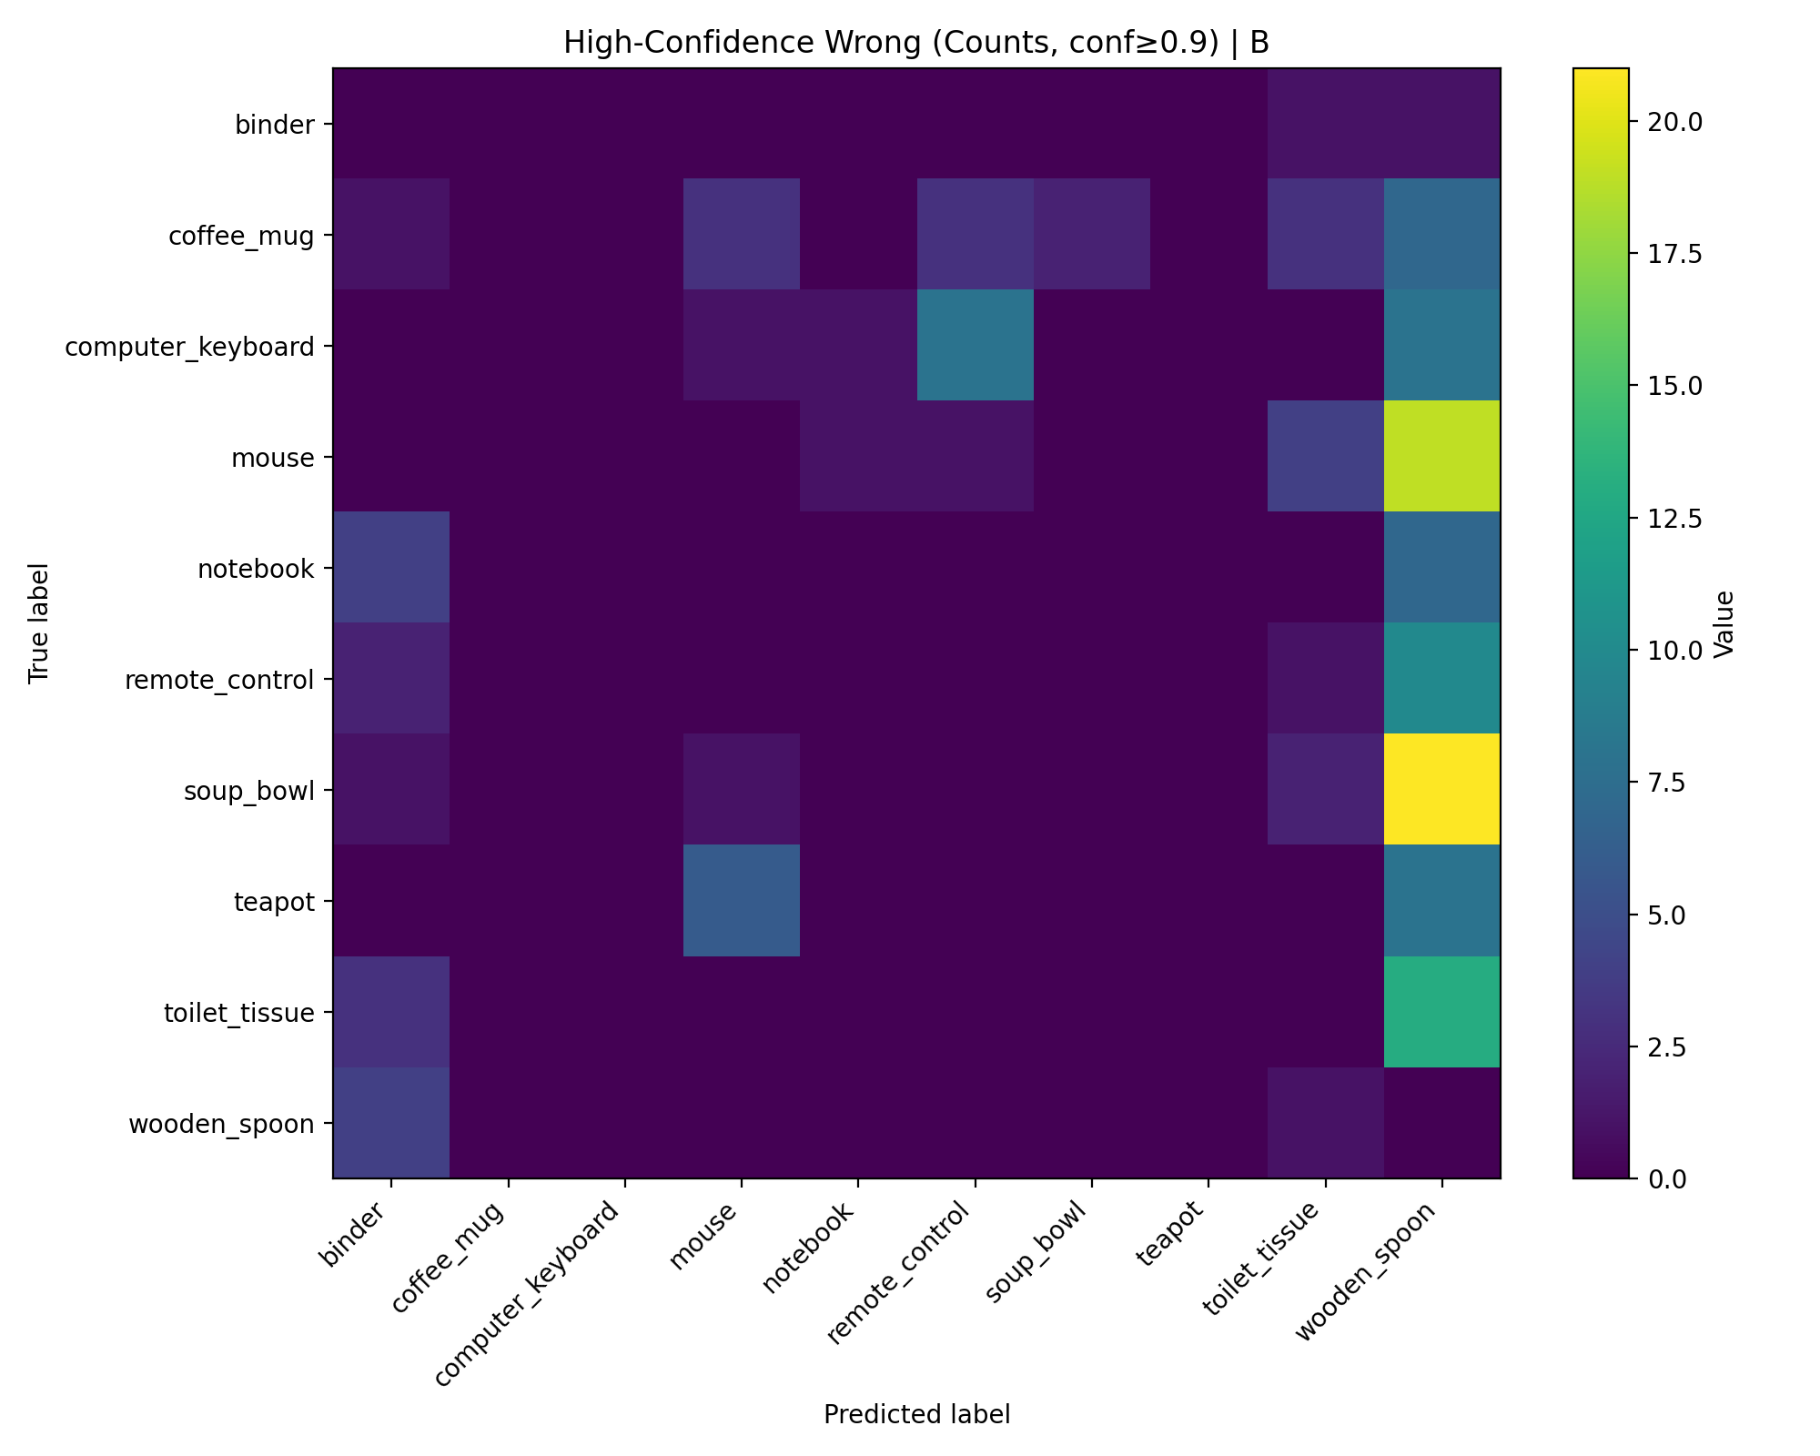
Focused confusion on high-confidence wrong

Slide 15
From Error Statistics to Visual Explanation
Similar accuracy, but different error confidence behavior
Hidden differences beyond aggregate performance
Next goal:
understand how errors are made
And whether training choices shape these failures

Slide 16
Interim Summary: What We Learned So Far
So Far
Model A: few, mostly shared HCWs
Models B & D: many model-specific HCWs
Suggests training choices shape failure behavior

Slide 17
Visual Explanation with Grad-CAM
What is Grad-CAM?
Visual explanation method for CNNs
Highlights regions important for a specific prediction
Produces a class-specific heatmap
Method (Our Use Case)
Apply Grad-CAM to high-confidence wrong predictions
Analyze whether the model focuses on object region or spurious cues

Slide 18
Behavior-Driven Sample Selection for Cross-Model Comparison
Grad-CAM is not applied to all samples
Focus on samples that best reveal behavioral differences
Samples selected based on decision divergence between models
Using difficulty tables to identify:
High-confidence wrong vs not
Enables fair and symmetric cross-model comparison
Bidirectional analysis for each model pair
This results in eight symmetric comparison groups

Slide 19
Why Eight Comparisons?
Control Factor | Model Pair | Direction 1 | Direction 2
Same strategy | IN-LP vs FL-LP | IN-LP HCW → FL-LP | FL-LP HCW → IN-LP
Same strategy | IN-FT vs FL-FT | IN-FT HCW → FL-FT | FL-FT HCW → IN-FT
Same pretraining | IN-LP vs IN-FT | IN-LP HCW → IN-FT | IN-FT HCW → IN-LP
Same pretraining | FL-LP vs FL-FT | FL-LP HCW → FL-FT | FL-FT HCW → FL-LP

Slide 20
Why Eight Comparisons?
Control Factor | Model Pair | Direction 1 | Direction 2
Same strategy | IN-LP vs FL-LP | IN-LP HCW → FL-LP | FL-LP HCW → IN-LP
Same strategy | IN-FT vs FL-FT | IN-FT HCW → FL-FT | FL-FT HCW → IN-FT
Same pretraining | IN-LP vs IN-FT | IN-LP HCW → IN-FT | IN-FT HCW → IN-LP
Same pretraining | FL-LP vs FL-FT | FL-LP HCW → FL-FT | FL-FT HCW → FL-LP

Slide 21
Control Factor | Model Pair | Direction 1 | Direction 2
Same strategy | IN-LP vs FL-LP | IN-LP HCW → FL-LP | FL-LP HCW → IN-LP
Same strategy | IN-FT vs FL-FT | IN-FT HCW → FL-FT | FL-FT HCW → IN-FT
Same pretraining | IN-LP vs IN-FT | IN-LP HCW → IN-FT | IN-FT HCW → IN-LP
Same pretraining | FL-LP vs FL-FT | FL-LP HCW → FL-FT | FL-FT HCW → FL-LP

Slide 22
Shared High-Confidence Errors as a Starting Point
Define shared high-confidence wrong predictions
Identified via cross-model comparison of difficulty tables
Same images misclassified with high confidence by all models
Serve as a model-independent failure subset
Analyzed using Grad-CAM

Slide 23
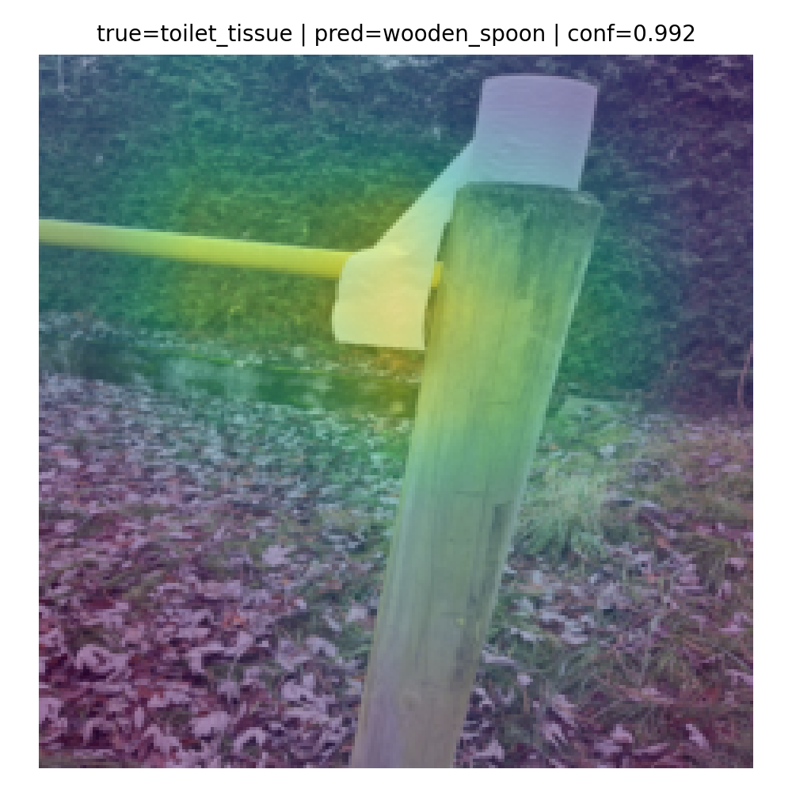
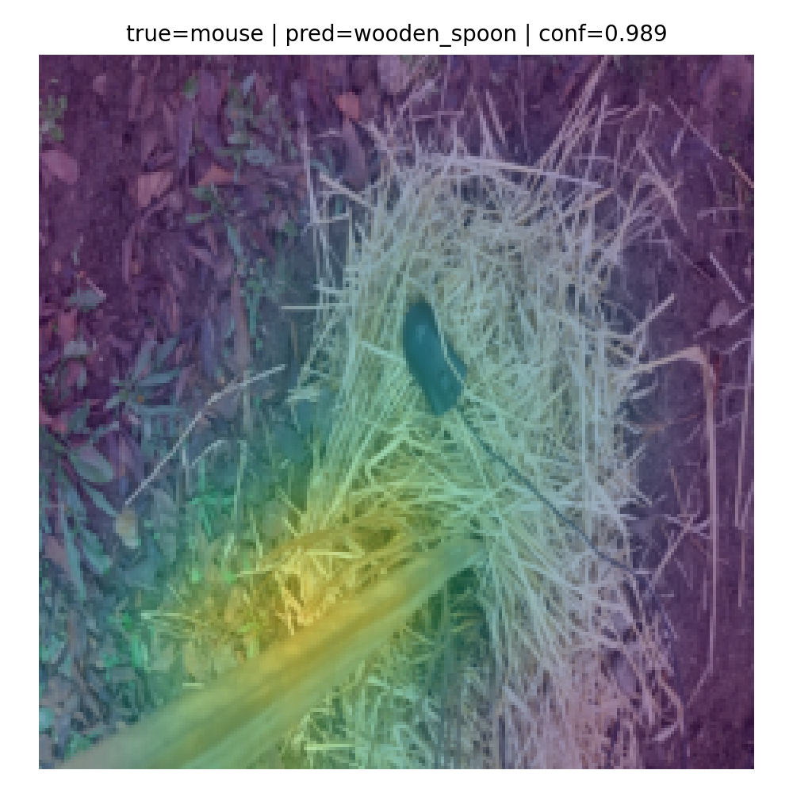
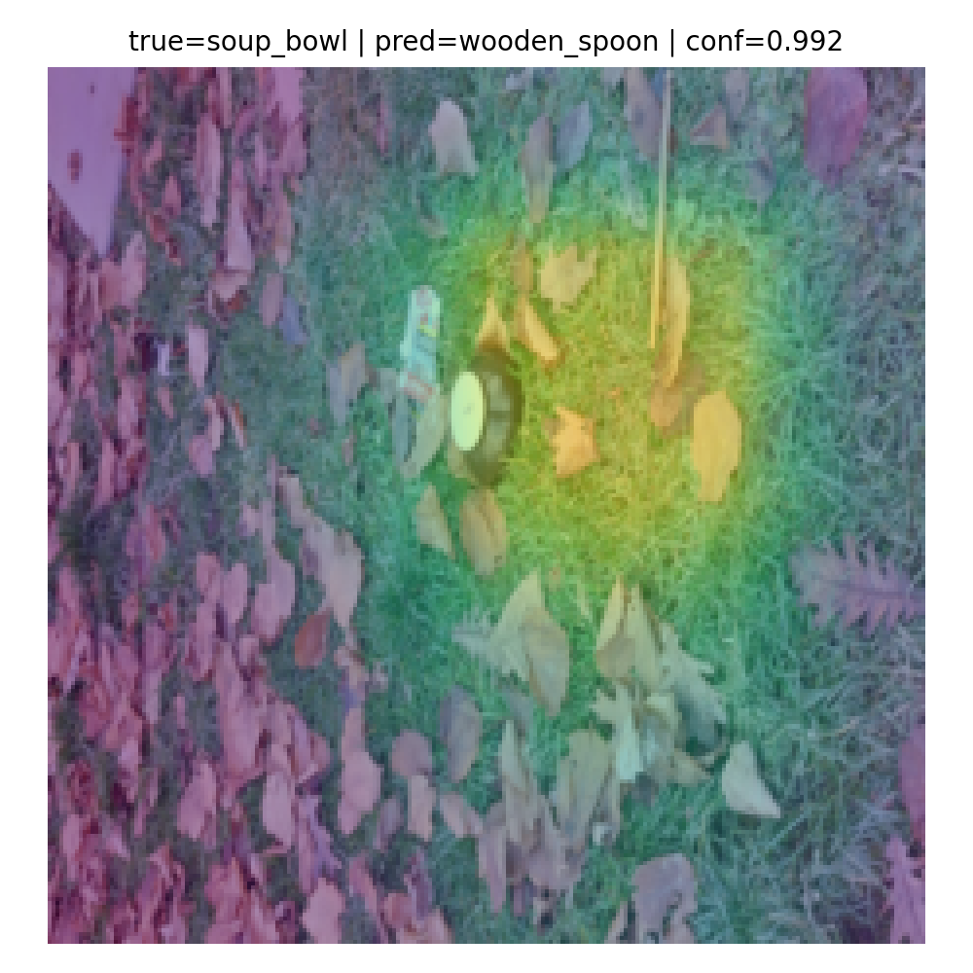
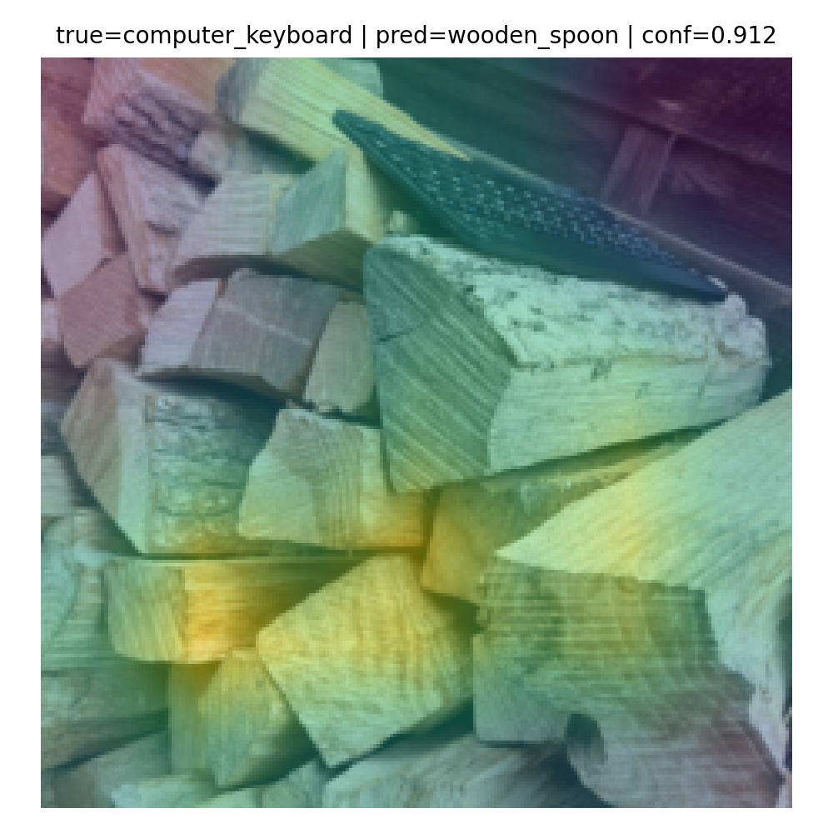
Initial Grad-CAM Observations
Grad-CAM highlights are often consistent across different objects
The model frequently focuses on:
elongated / rod-like regions
brown or wood-like textures
background regions instead of the object itself

Slide 24
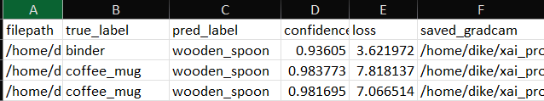
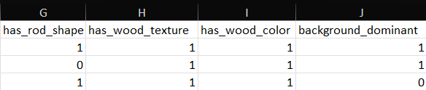
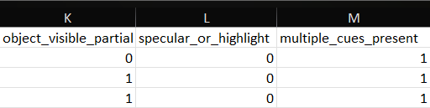
Structuring Grad-CAM Insights into Interpretable Features
For each high-confidence error image:
we annotate several binary visual cues
Each image is represented as a feature vector
These features are not mutually exclusive
multiple cues can co-exist

Slide 25
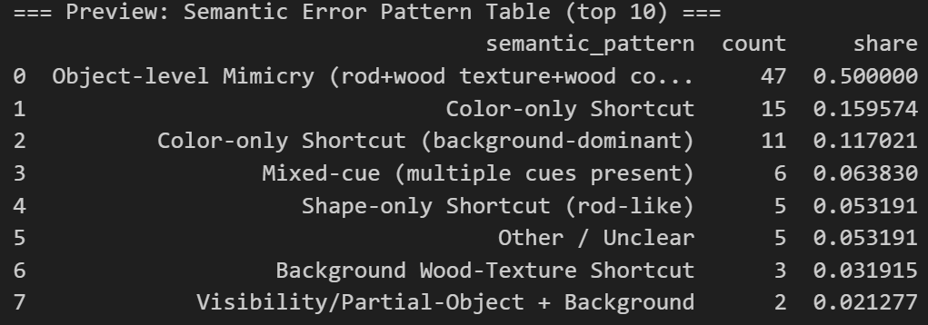
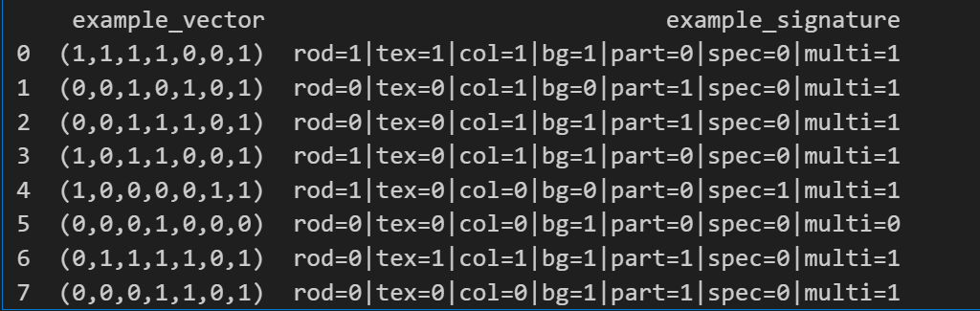
From Feature Vectors to Semantic Error Patterns
Object-level Mimicry (~50%)
Color-only Shortcut

Slide 26
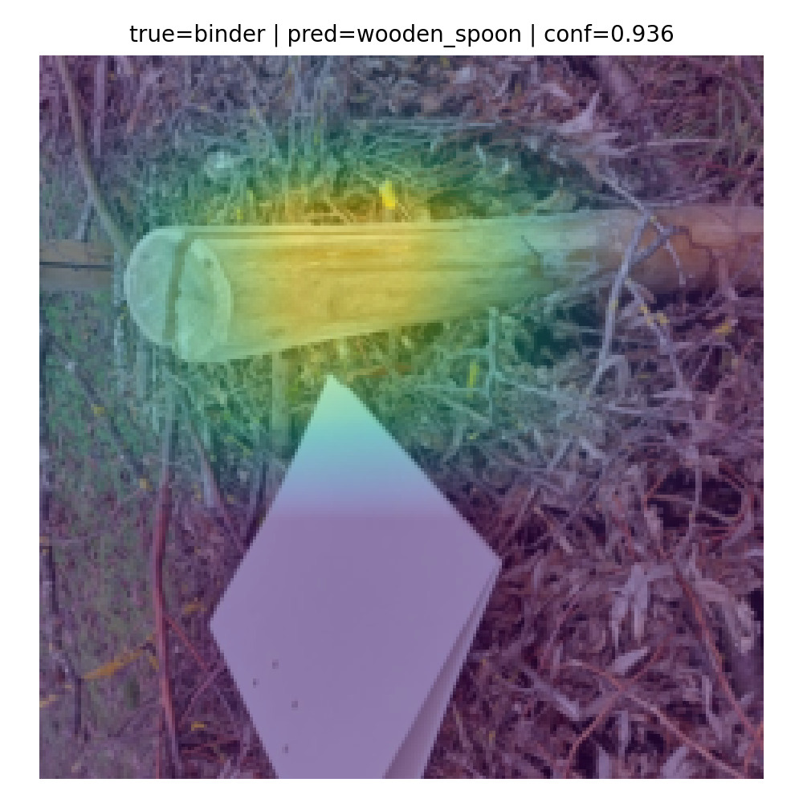
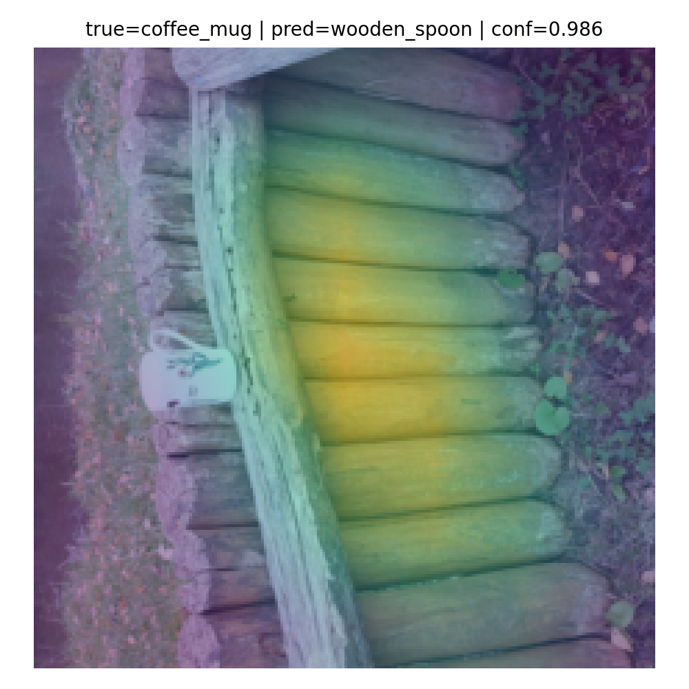
Object-level Mimicry

Slide 27
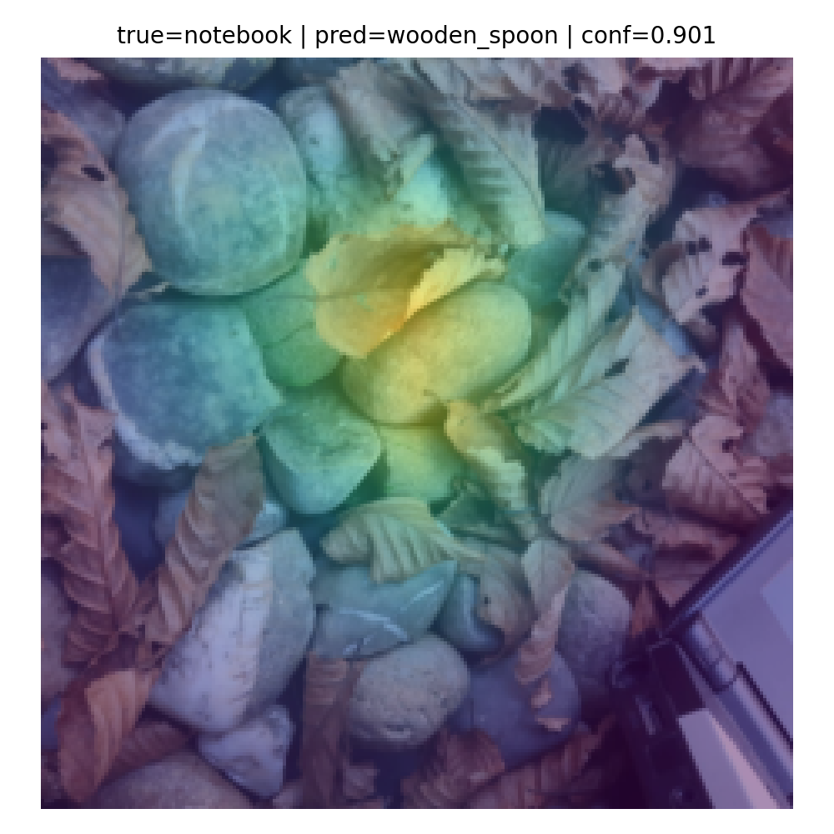
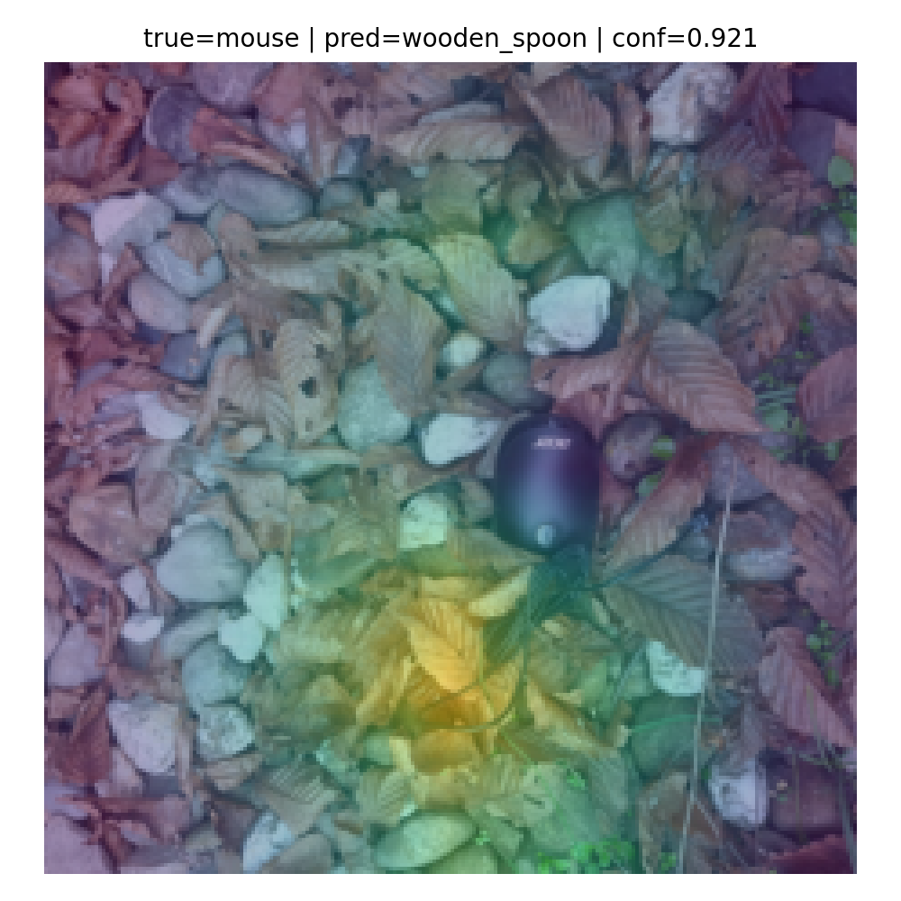
Color-only Shortcut

Slide 28
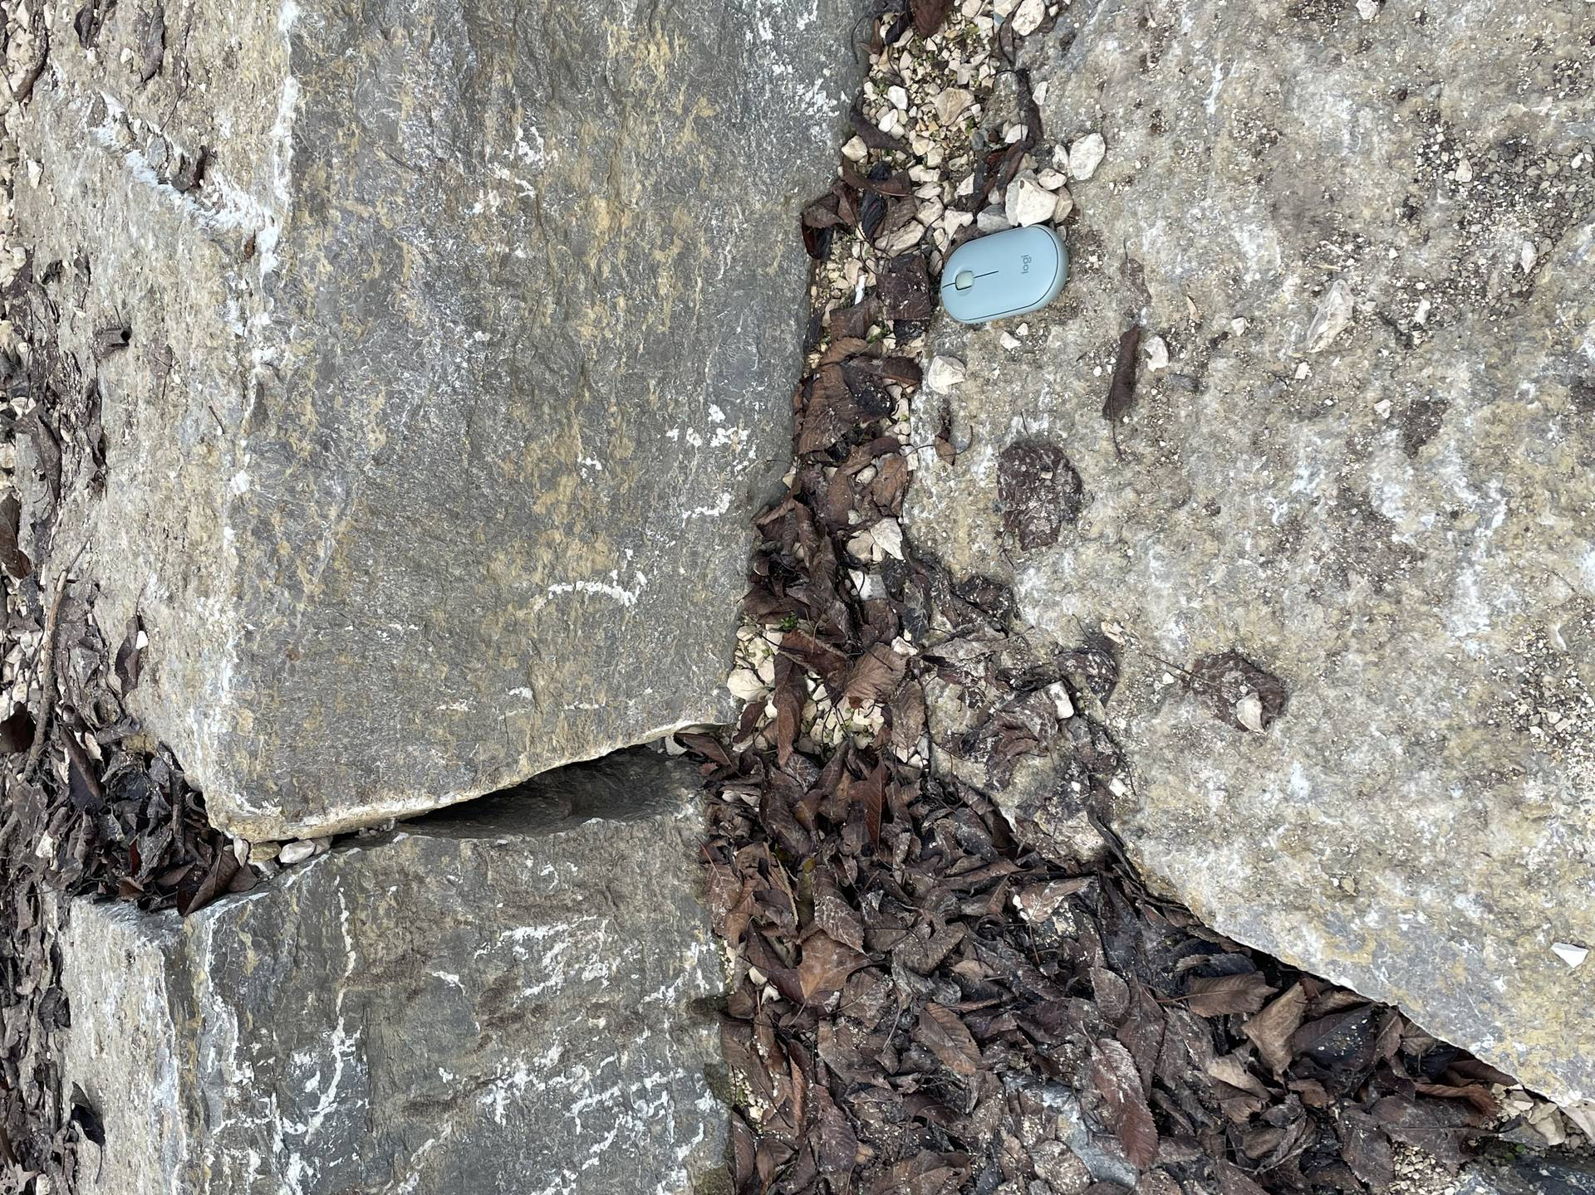
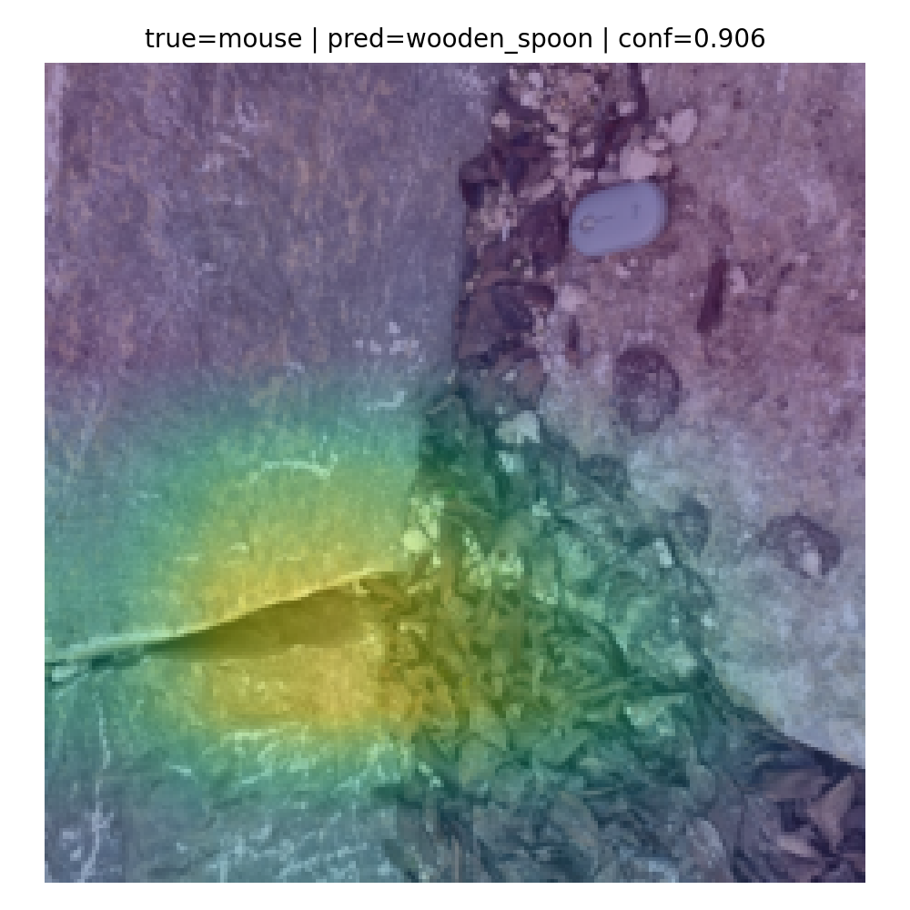
Other / Unclear

Slide 29
Key Insights from Explainable Error Analysis
Key Takeaways
Grad-CAM reveals that high-confidence errors are systematic, not random
Most errors can be explained by a small number of semantic visual patterns
The model relies on visual shortcuts, especially for the class wooden_spoon

Slide 30
Future Work and Next Steps
Future Work
Validate semantic error patterns across different models
Mitigate shortcut behavior through data-level interventions
Combine explainability with quantitative robustness evaluation

Slide 31
Grad-CAM Insights
Observation
Attention focuses on:
wooden textures
elongated shapes
background regions
Interpretation
Shortcut / texture bias
Overgeneralization of wooden_spoon features

Slide 32
Reflection, Trust & Next Steps
Reflection
Accuracy ≠ reliability
Explainability changes how we trust models
Next Steps
Cross-model comparison
Calibration checks
Data diversity

Slide 35
